Slide 1




Computer Vision
Final Project Presentation
Handwritten Digit Recognition
Presented by: Yusif Hajizade
yusif.hajizade@ufaz.az
ID: 22022735
01

Slide 2


02
COMPUTER VISION
Abstract
Introduction
Agenda
Goals
Main
Libraries
Methods
Results
Conclusion
References

Slide 3
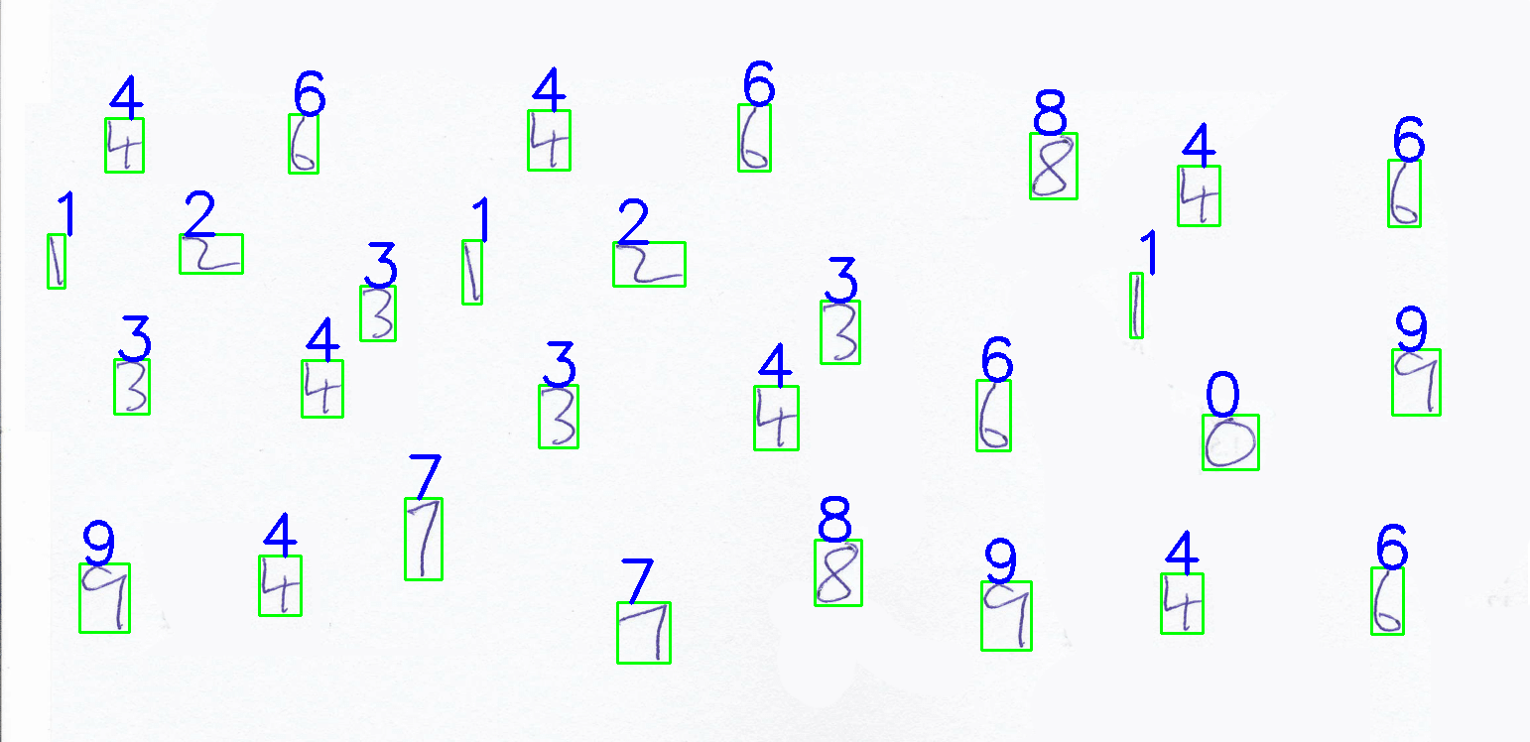

Back to Agenda Page
Abstract
This project focuses on handwritten digit recognition, employing image processing techniques and machine learning algorithms to accurately identify digits in images. By leveraging custom datasets and the MNIST dataset, along with Histogram of Oriented Gradients (HOG) descriptors, the models achieve significant accuracy in digit recognition. The integration of image processing and machine learning contributes to advancements in handwritten digit recognition technology.
03

Slide 4
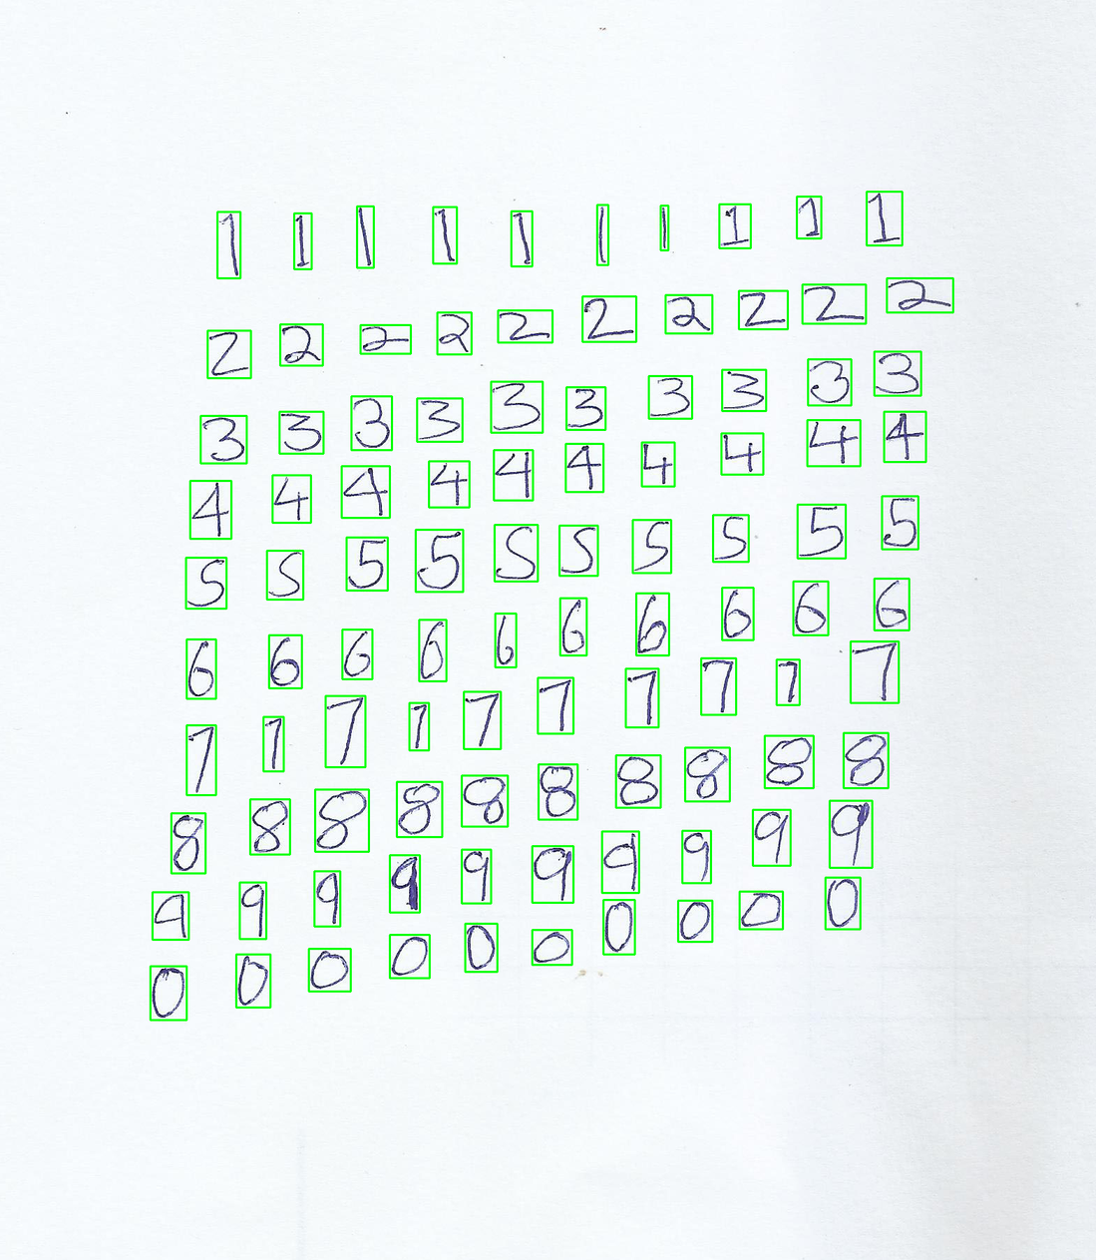
Back to Agenda Page
Introduction
Handwritten digit recognition is essential in various domains such as postal mail sorting and bank check processing, but it poses challenges due to variations in writing styles and orientations. This project addresses these challenges by implementing image processing techniques and machine learning algorithms to accurately identify handwritten digits.
03
04

Slide 5



Goals
Develop an efficient system for accurately recognizing handwritten digits in images using computer vision and machine learning techniques.
Implement robust feature extraction methods such as Histogram of Oriented Gradients (HOG) to capture shape information crucial for digit recognition.
Train custom K-Nearest Neighbors (KNN) and Support Vector Machine (SVM) models to achieve high accuracy in classifying handwritten digits, surpassing standard benchmarks.
05
Back to Agenda Page

Slide 6



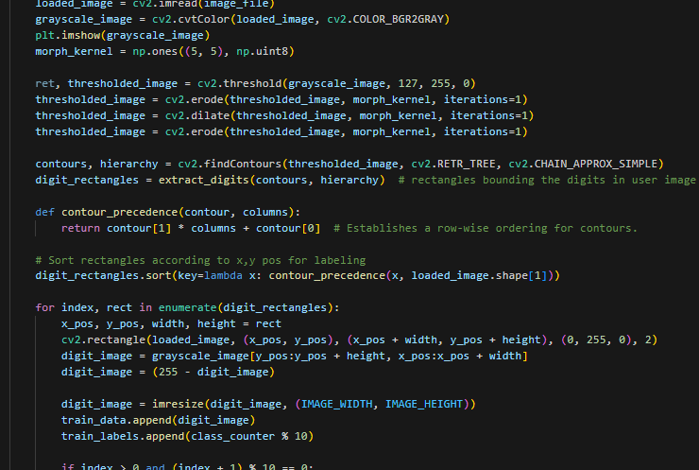

COMPUTER VISION
Main
The main components of the project include data preparation, model training, and image processing. The project utilizes custom handwritten datasets and the MNIST dataset for training, preprocesses images using OpenCV, and extracts features using Histogram of Oriented Gradients (HOG) descriptors.
Back to Agenda Page
06

Slide 7
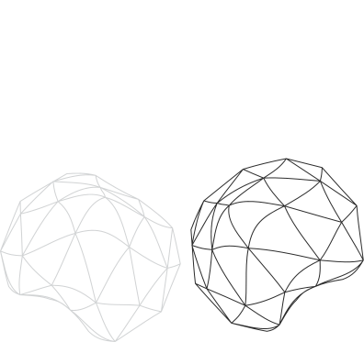
Methods
Divide Image: This method divides input training images into smaller cells containing single digits for training purposes. | Resize Images: Resizes input images to a specified size using the Python Imaging Library (PIL) for consistency in training and prediction.
Feature Extraction: Histogram of Oriented Gradients (HOG) descriptors are computed for digit images to capture shape information. | Loading Images: Loads custom handwritten digits or MNIST dataset for training the digit recognition model.
Extract Digits: This method extracts digits from images by identifying contours and bounding boxes encapsulating each digit. | Image Processing: Processes input images by converting them to grayscale, applying thresholding and morphological operations for segmentation, and detecting contours to isolate individual digits.
Back to Agenda Page
07

Slide 8
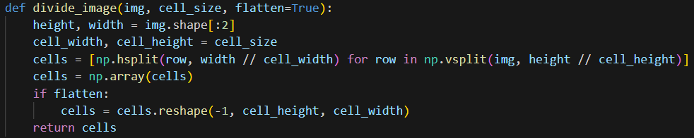
Split/Devide Image
08
This method divides the input training image into smaller cells, each containing a single digit. The image is divided into cells based on a specified cell size, extracting regions of interest that contain individual digits. This step is crucial for isolating and processing each digit separately during training and prediction. Function segments an image into smaller cells determined by the given cell size, extracting image dimensions first. These cells are then created both horizontally and vertically. Optionally, if the `flatten` parameter is True, the array of cells is flattened to a single dimension per cell, before being returned for additional processing or analysis.

Slide 9
Histogram of Oriented Gradients
09
Histogram of Oriented Gradients (HOG) descriptors are computed for the digit images to capture shape information. HOG features represent the distribution of gradient orientations in localized regions of the image. By extracting HOG descriptors, the model can learn distinctive patterns and shapes associated with handwritten digits, improving recognition accuracy. The compute_hog_descriptors function iterates over a set of images to extract Histogram of Oriented Gradients (HOG) descriptors. These descriptors are calculated with specific parameters such as the number of orientations, pixels per cell, and cells per block. The resulting HOG features are returned as a NumPy array for further processing or analysis.

Slide 10
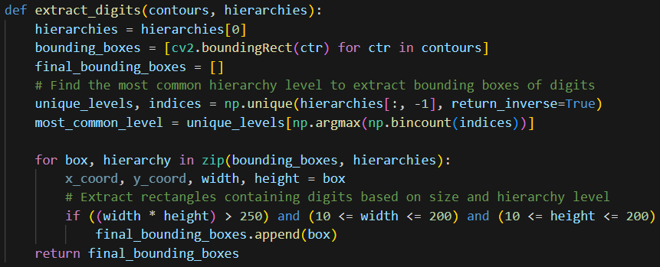
10
Extract Digits
This method extracts the digits from the image by identifying contours and bounding boxes that encapsulate each digit. It filters the extracted contours based on size and hierarchy level to isolate individual digits. This step ensures that only relevant regions containing digits are considered for further processing and analysis. The extract_digits function takes contours and their corresponding hierarchies as input and returns the bounding boxes of the digits found in the image. It filters out bounding boxes based on size and hierarchy level to extract only the ones containing digits, avoiding nested bounding boxes within digits.

Slide 11
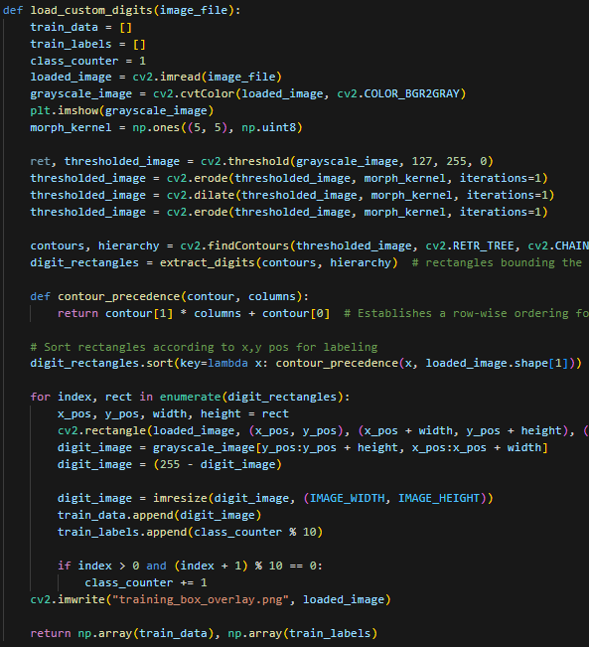
Loading Digits
This method loads the custom handwritten digits dataset or the MNIST dataset for training the digit recognition model. It reads the image files, preprocesses them, and prepares the data for training by extracting digits and their corresponding labels. Loading images is a crucial step in preparing the dataset for training the model on handwritten digit data. The load_custom_digits function processes a custom training image, extracting individual digit images and their corresponding labels. It utilizes contours to identify and extract digits, sorts them for labeling, and prepares the data for training a digit recognition model.
11

Slide 12
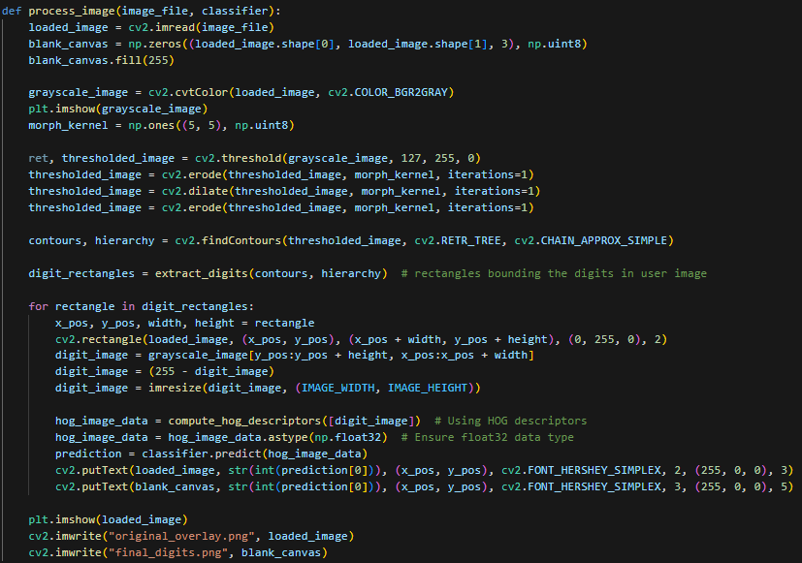
Image Processing
The image processing phase segments the input image, detects contours for digit isolation, extracts Histogram of Oriented Gradients (HOG) descriptors for classification, predicts labels using a trained classifier, and overlays results onto the original image for visualization. Updated variable names and comments enhance readability.
12

Slide 13
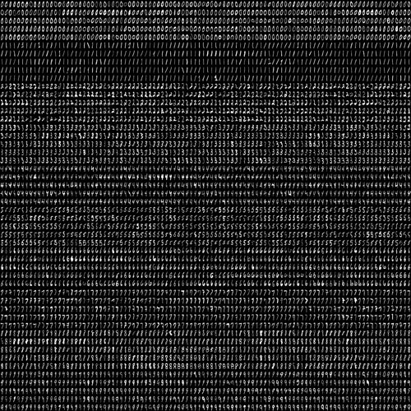
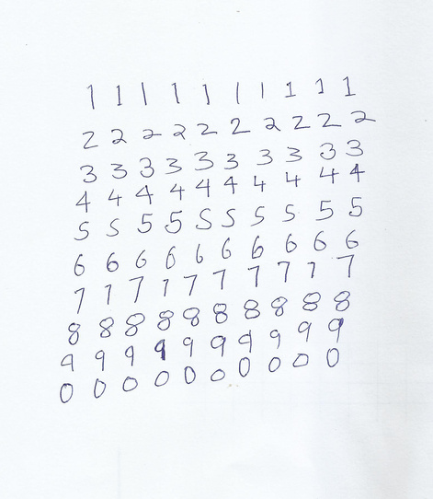
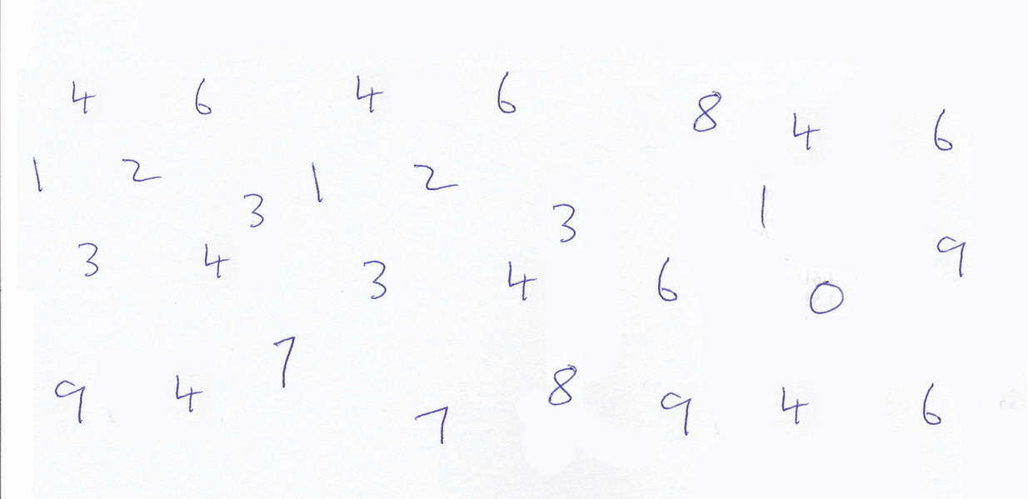
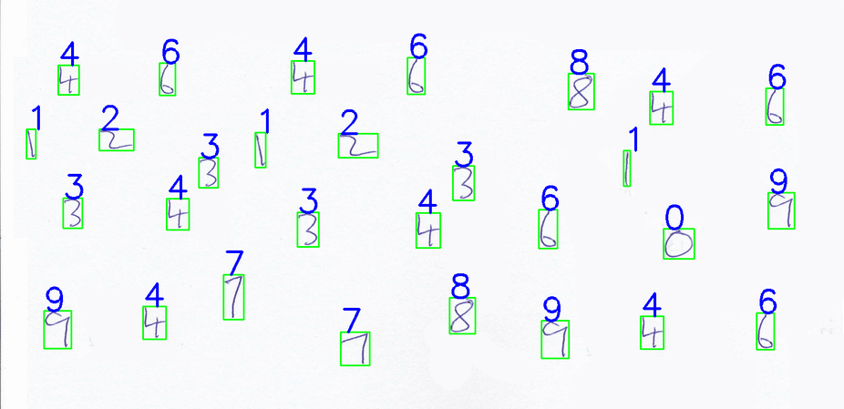
13
UML DIAGRAM OF PROCESSES
Training Models:
KNN and SVM
Image Reconginition using trained model
Training datapool of handwritten digits
my own handwritten digits used as training data
After training implement bxing after identification digits
Sample Image for testing the system
Add even more
sub-ideas

Slide 14

ORIGINAL HANDWRITE
IMAGE
FINAL PROCESSED
IMAGE
COMPUTER VISION
Results
he project achieves promising results with accuracies of around 80% on test images, demonstrating the effectiveness of the approach in accurately identifying handwritten digits.
This is the original image written by me on paper, then scanned and converting into j[pg format
This is the original image with digit boxes and the identified number placed above handwritten.
14
Back to Agenda Page

Slide 15



15
Conclusion
Handwritten digit recognition is a challenging task, but through the integration of image process-ing techniques and machine learning algorithms, this project demonstrates significant progress in addressing the problem. 11 By leveraging custom datasets and advanced feature extraction methods like HOG descriptors, the project achieves accurate digit recognition results. Overall, the project contributes to the advancement of handwritten digit recognition technology, with potential appli-cations in various fields.

Slide 16



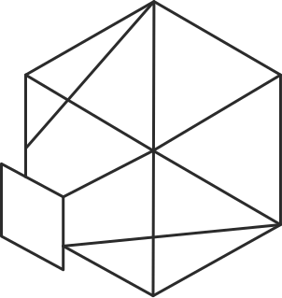
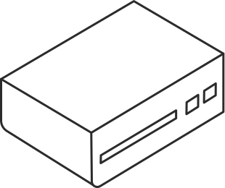
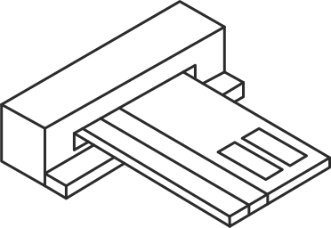





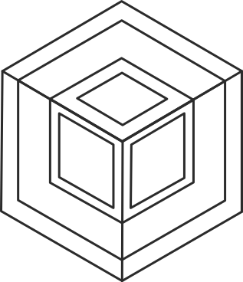
16
References
Digit Recognizer | Kaggle. (n.d.). https://www.kaggle.com/competitions/digit-recognizer
Pavitrakumar. (n.d.-b). GitHub - pavitrakumar78/Street-View-House-Numbers-SVHN-Detection-and-Classification-using-CNN: A 2-CNN pipeline to do both detection (using bounding box regression) and classification of numbers on SVHN dataset. GitHub. https://github.com/pavitrakumar78/Street-View-House-Numbers-SVHN-Detection-and-Classification-using-CNN
Pavitrakumar. (n.d.-a). GitHub - pavitrakumar78/Python-Custom-Digit-Recognition: Using OpenCV in python to recognize digits in a scanned page of handwritten digits. GitHub. https://github.com/pavitrakumar78/Python-Custom-Digit-Recognition
Team, D., Team, D., & Team, D. (2021, March 14). Deep Learning Project – Handwritten Digit Recognition using Python. DataFlair. https://data-flair.training/blogs/python-deep-learning-project-handwritten-digit-recognition/

Slide 17
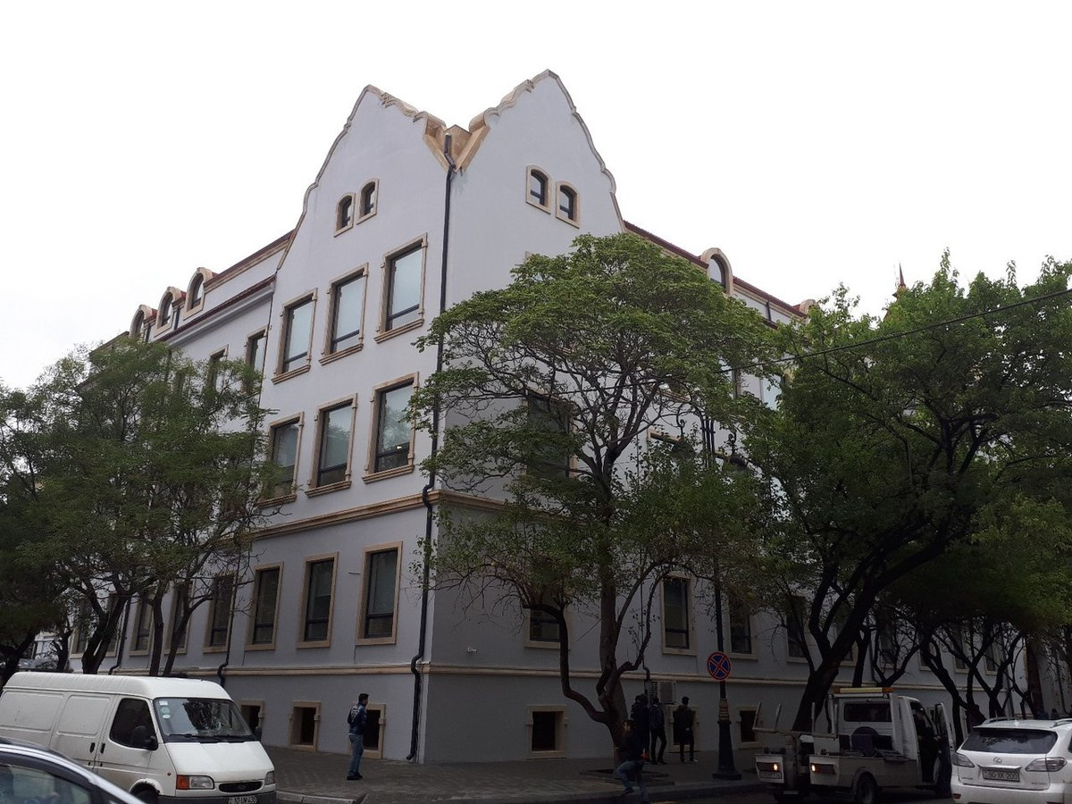

COMPUTER
VISION
Student Info
NAME
EMAIL
Yusif Hajizade
yusif.hajizade@ufaz.az
STUDENT ID
22022735
GITHUB
https://github.com/JosephHajinsky/Computer-Vision-Handwrite-Digit-Recognition

